Slide 2
The big problem
Rising extremism and polarization are due to a complex interaction of factors including communicative, cognitive, and social factors. How can we predict this?
We know certain communication strategies exacerbate extremism and polarization. But how do we estimate the impact of a communication strategy known to increase extremism and polarization?
Notes:
Communication strategies

Slide 3
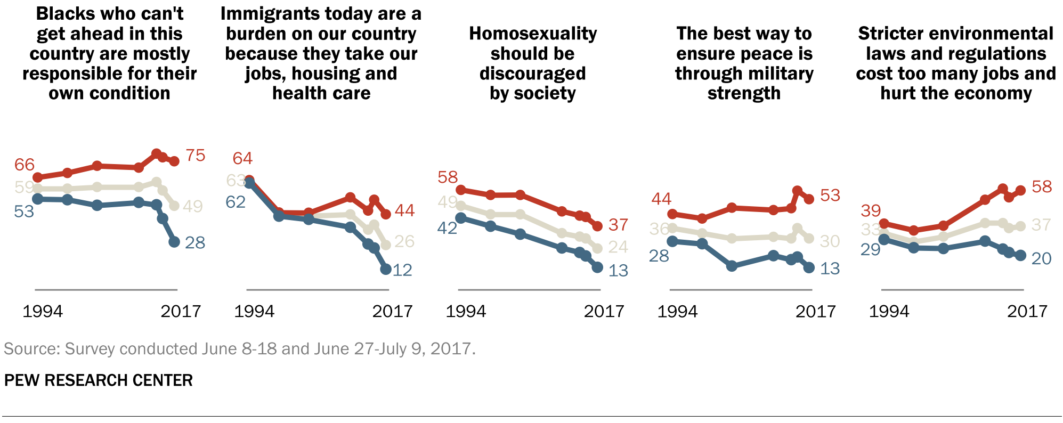
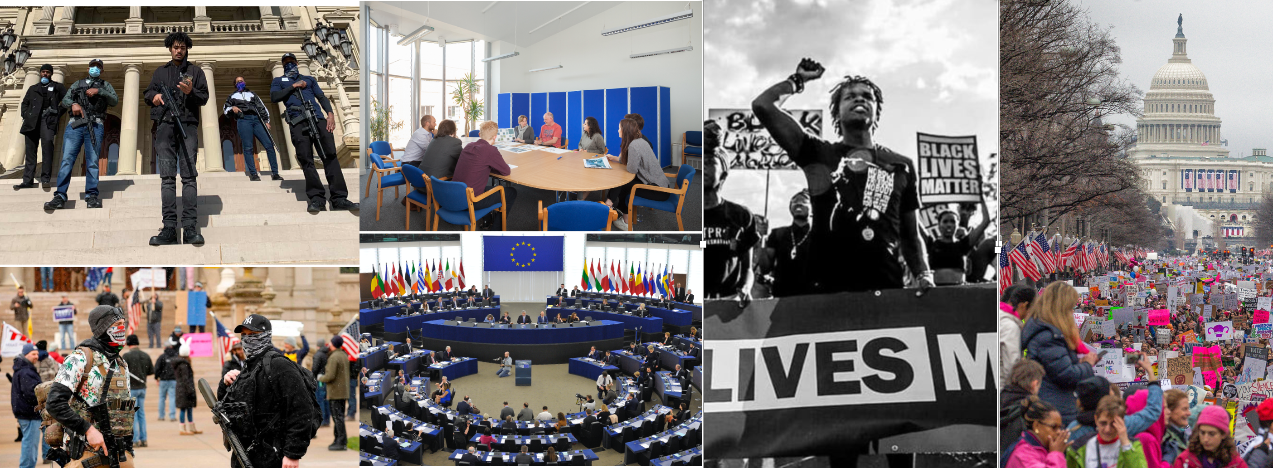
The big problem
Rising extremism and polarization are due to a complex interaction of factors including communicative, cognitive, and social factors. How can we predict this?
We know certain communication strategies exacerbate extremism and polarization. But how do we estimate the impact of a communication strategy known to increase extremism and polarization?
This is an immense problem that no single dissertation, individual, or research lab can solve. As such we limit our focus to some specific phenomena and analyses to learn about certain components of this highly complex system.
﻿Pew Research Center. (2017, October). The Partisan Divide on Political Values Grows Even Wider, 1–23.
Notes:
Communication strategies include misinformation, covert signaling, and violent rhetoric. In this dissertation I focus on violent rhetoric, specifically violence metaphors that connect the abstract conceptual domain of politics to the embodied domain of interpersonal violence.

Slide 4
A simple two-step model of the big problem
1a. Elite media node (e.g. MSNBC) in social network uses communication strategy
Media
1b. A portion of media consumer opinions and communication strategies change after receiving communication.
Notes:
Communication strategies include misinformation, covert signaling, and violent rhetoric. In this dissertation I focus on violent rhetoric, specifically violence metaphors that connect the abstract conceptual domain of politics to the embodied domain of interpersonal violence.

Slide 5
A simple two-step model of the big problem
1a. Elite media node (e.g. MSNBC) in social network uses communication strategy.
Media
1b. A portion of media consumer opinions and communication strategies change after receiving communication.
2. Media consumers repeat the communication strategy to other consumers who may not have been exposed to original; opinions and communication strategies are updated again.
Notes:
Communication strategies include misinformation, covert signaling, and violent rhetoric. In this dissertation I focus on violent rhetoric, specifically violence metaphors that connect the abstract conceptual domain of politics to the embodied domain of interpersonal violence.

Slide 6
More specific problems to answer.
How often is metaphorical violence used on cable TV news, and qualitatively what is it like (content & contexts)?
In general, how predictable is extremism and polarization, and what factors are theoretically important to explain their emergence?
How do we think about and measure changing opinions?

Slide 7
What I did to begin to solve these problems.
Understood when and why metaphorical violence is used on cable TV news in the context of presidential elections.
Explored and defined limits to the predictability of , as well as showed the importance of communication noise
In order to know if one’s support for, e.g., political violence becomes more extreme, we must somehow measure their opinions on this issue. I show that many studies of how opinions become more extreme among initially biased groups are unreliable, i.e. worthless, due to a mismatch between theoretical opinion distributions and real world opinion measurement techniques.

